Slide 1
STRUCTURED ENQUIRY
Event Management
System

Slide 2
Consider an event management system, the event is defined by event(eventide, title, eventType, location, totalCharges, status (completed/ ongoing/ booked)). The event types are IndoorEvent and OutdoorEvent. The OutdoorEvents are charged per hour and IndoorEvents are charged per day. The booked events can be cancelled and the ongoing and completed events cannot be cancelled.

Slide 3
Perform the following : 1. Create few indoor and outdoor events. 2. Compute charges for the each event conducted. 3. Print event details and cancelled events. 4. The application also print total revenue generated by organising events. 5. Identify runtime errors/exceptions and manage.

Slide 4
Classes identified : EventSystem, Event, IndoorEvent, OutdoorEvent. Relationships : 1. EventSystem has Event. 2. IndoorEvent is Event. 3. OutdoorEvent is Event.

Slide 5
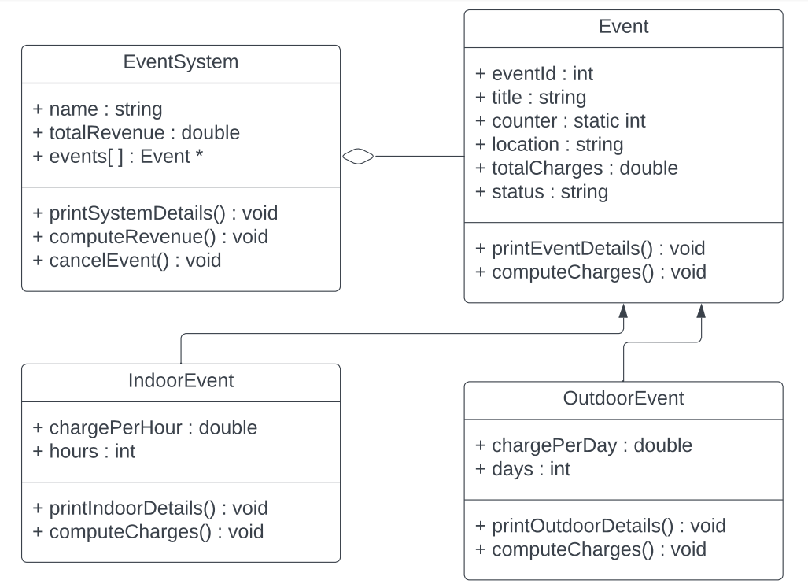
UML DAIGRAM :-

Slide 6
Output :

